Slide 1

Real Estate Management System.
Presented by:
Zaka Tabish Shaikh(210)
Shaikh Mohammed(217)
Mohammed Faisal(230)
Mohammed Abedi(229)

Slide 2
Introduction
1) Real estate Management System is basically web-based software.
which is use to buying, of properties through this internet.
2) This Software solution will ease the management of real estate businesses.
3) In Real Estate there are lots of calculations like keeping record of Properties in terms of location, rate, number of registered members, and especially calculations of Loan EMI calculation concept at the time of transaction etc. These calculations are not only complicated but also brain eating.

Slide 3
4) Our project also consists of individual detail of property, customer’s detail’s, and feedback’s details.
5) So the owner can have all these details in his personal computers rather than having hundreds of registers.
6) System is operational feasible since the user are familiar with the simple technologies. So, the system is very user friendly and easy to use.

Slide 4
Problem Statement
1) Lack of trust of people in modern world.
2) Traditional concept of buying houses and other property.
3) It is many time consuming to visiting many place for searching property.

Slide 5
Statement of the
Problem
The aim of the project is to bring the real estate management online enabling real estate management participants to benefit from the Internet.
The data will be stored properly in data stores, which will help in retrieval of information as well as its storage, Data is more secure.
Participants can access its information and manage all the adding, updating, deleting and some of its tasks.

Slide 6
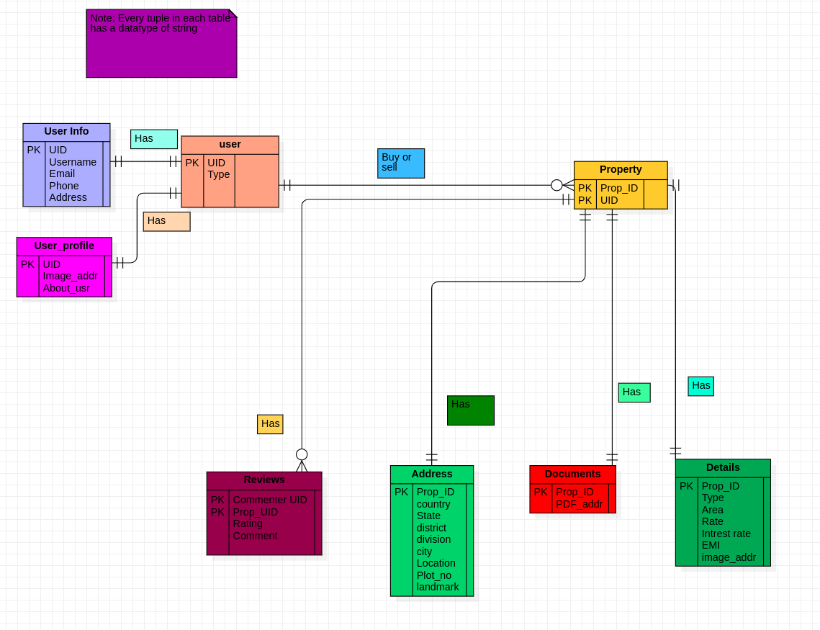
Table form our project

Slide 7
Literature Review
Nowdays there are many Real estate website are available in market. But with my view many issues are finds as follows:
Not a customer satisfied.
Trustless.
More expensive.
Many traditional technology uses.

Slide 8
Here are some features which we have studied and analize through literature survey:
Budgeting, Reporting, CRM, Chatbot Contact Center, Resident, Screening, Marketing, Payments, Utilities, Online Leasing, Online Portal, Property Maintenance, Affordable Compliance, Lead Management, Resident Credit Reporting, Investor Management,
* By Role
Property Managers
Property Accountants
Property Marketing
Property Maintenance
* Integrations
Debt Collection
Internet Listing Services
Payment Processing
Search All Integrations ,These some following features we have seen on literature survey

Slide 9
SYSTEMS ANALYSIS
Tool and technology
Software requirement
Server: Xampp
Front-End: html, css, javascript
Back-End: php, mysql

Slide 10
CONCLUSION
Learning is a never-ending process. Our work is just the first steps to the particular approach of implementation of real estate management system.
This software system will be keeping quality assurance and user satisfaction at extreme level.
We will be providing you many option to search your dream properties like office, housing land, houses, flats, etc.
The most important feature of this system is online exhibiting the properties, this saves our time to visit the actual place where the property is located.

Slide 11



THANK
YOU

